Slide 1
Software Design And Analysis(SDA)
Week – 01
Lecturer: Noureen Fatima
Noureen.fatima@nu.edu.pk

Slide 2




Course Catalogue - HEC
 Object-Oriented Analysis: Developing the Static Model, Class Diagrams, UML Relationships: Association, Aggregation, Composition, Inheritance. UML Packages, Object Diagrams.
Object-Oriented Analysis: Developing the Dynamic Model ,Use Case Diagrams, Sequence Diagrams, Collaboration Diagrams, Statechart Diagrams, Advanced States: Substates, Superstates,Activity Diagrams.

Slide 3

Course Goals
 After successful completion of this course students should be able to do analysis of software system. Do modeling using UML and create diagram like use cases, activity, class, sequence, collaboration etc.

Slide 4


Slide 5
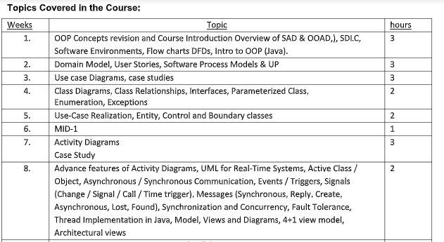
Course Outline

Slide 6
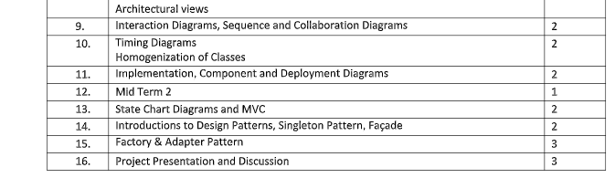
Course Outline

Slide 7
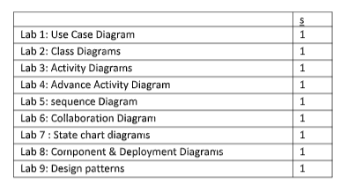
Course Outline

Slide 8
Books
UML 2.0 in Action by Patrick Graessle
Systems Analysis and Design with UML 3rd Edition by Alan Dennis
UML Distilled, 3rd Edition by Martin Flower
Visual Modeling with Rational Rose by Terry Quatranie
Unified Software Development by Booch, Rambaugh, Jacobson

Slide 9
Marks Distribution (Assessments / Grading)
Mid - 28wtg (14*2)
Assignment - 8 wtg (Lab)
Quiz - 6 wtg (3 * 2)
Project – 8 wtg
Final - 50

Slide 10
Week one – Class One

Slide 11
What is POP (procedural-Oriented-Programming)
A procedural language is a sort of computer programming language that has a set of functions, instructions, and statements that must be executed in a certain order to accomplish a job or program.
Procedural languages include BASIC, C, FORTRAN, Java, and Pascal, to name a few.
features:
Modularity
Predefined Function
Scoping
Advantages
portable
Function
Flow Tracking
Disadvantages
large scale
not work for real world problem
Data Security

Slide 12
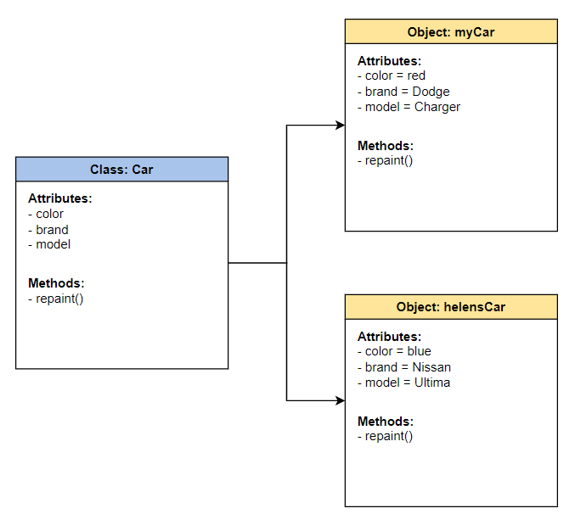
let’s talk about OOP
Object-Oriented Programming (OOP) is a programming paradigm in computer science that relies on the concept of classes and objects.
It is used to structure a software program into simple, reusable pieces of code blueprints (usually called classes),
which are used to create individual instances of objects.

Slide 13
Basic Concepts of Object Oriented Programming
It is necessary to understand some of the concepts used extensively in object-oriented programming. These include:
Objects
Classes
Data abstraction and encapsulation
Inheritance
Polymorphism

Slide 14
What is object-oriented programming?
There are four features of object-oriented programming to know:
Encapsulation
Abstraction
Inheritance
Polymorphism

Slide 15
Inheritance
Inheritance is a features of OOP which allow the user to inherit the common properties from other class
For example, Class Vehicle and class bike and Class car
Types of inheritance:
Single
Multiple
Multivel
Hierarchical
Hybrid

Slide 16
Polymorphism
https://www.phptutorial.net/php-oop/php-polymorphism/
polymorphism refers to ability to exist in multiple form. Multiple interface can be given to a single interface
For example: First, define an abstract class named Person that has an abstract method called greet().
Type f Polymorphism:
Static / Compile time ( Overloading)
Dynamic/ Run time (Overriding)
What’s different b/w these??

Slide 17
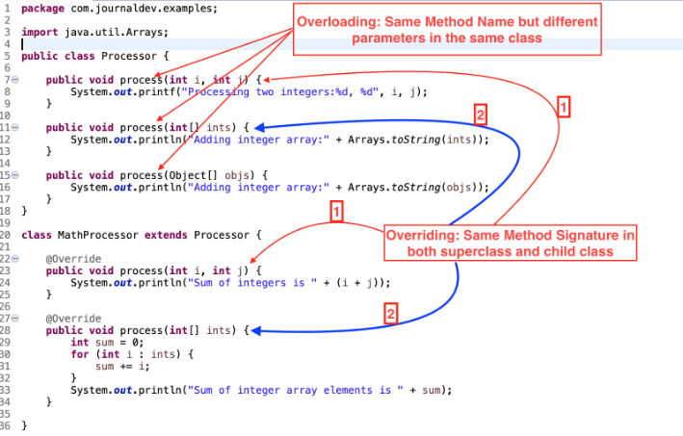
Overloading vs Overriding

Slide 18
Encapsulation
Encapsulation refers to binding the data and code that works on together in single unit.
For example: we have a class named as car and we have all the member functions and member variables wrapped inside this single unit and this binding of data is known as encapsulation.
Access Modifier:
Public
Private
Protected

Slide 19
Abstraction
Abstraction concept only allowing to display the important information and hide the implementation details from user.
Achieve by:
Abstract Class
Abstract Method

Slide 20
Real-life Example
We can take a real-life example of an Air conditioner (AC).
We have a remote control in order to control the various AC functions like start, stop, increase/decrease the temperature, control humidity, etc.
We can control these functions just with a clock of a button but internally there is a complex logic that is implemented to perform these functions.

Slide 21

Data Abstraction (Example)

Slide 22
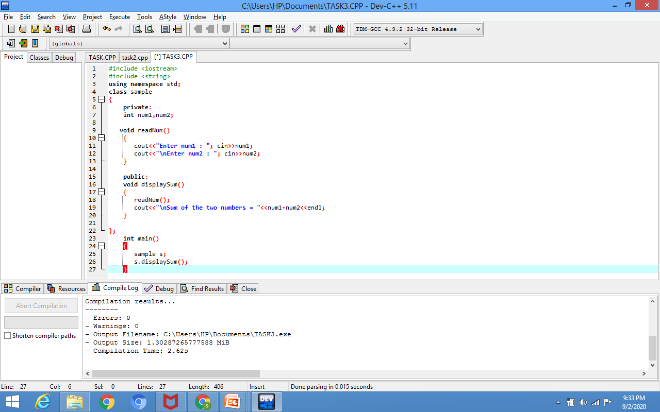
Example-Data Abstraction

Slide 23
Advantages of Information Hiding
Simplifies the model by hiding implementation details
Prevents accidental access
Prevents illegal access or manipulation

Slide 24
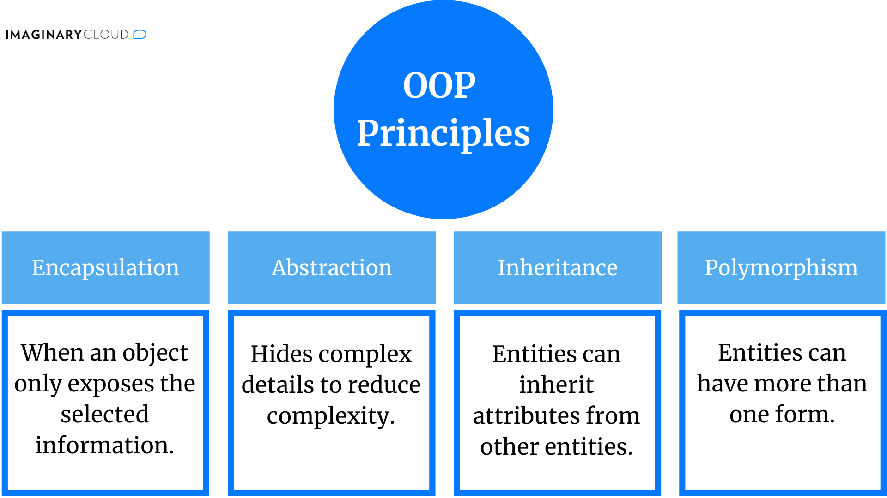

Slide 25
Procedural vs OOP
Flexibility
Object-oriented programming provides flexibility for your codebase through inheritance and polymorphism. Classes and objects (depending on the language) can also share properties and methods through inheritance. The child class or object inherits everything from its parent. When a child redefines something inherited from a parent, it is polymorphism.
Example: If you have an object called vehicle with a property of number of wheels and a method called drive, then you could create a child object called motorcycle. motorcycle would inherit drive and number of wheels, but you could update number of wheels to have a value of “2." If you ever update the method called drive on the vehicle object, then every child object (like motorcycle, scooter, or bus) would have the new drive method.

Slide 26
Access Specifiers
class MyClass { public: // Public access specifier int x; // Public attribute private: // Private access specifier int y; // Private attribute }; int main() { MyClass myObj; myObj.x = 25; // Allowed (public) myObj.y = 50; // Not allowed (private) return 0; }
The class members that have been declared as private can be accessed only from within the class. This facilitates data hiding which is also one of the key features of object-oriented programming.
The class members that has been declared as protected are accessible within the class and also in the derived class.
Public members can be accessed from outside of class as we
OutPut
error: y is private

Slide 27

Encapsulation
Encapsulation is a process of combining data members and functions in a single unit called class.
This is to prevent the access to the data directly, the access to them is provided through the functions of the class.
It is one of the popular feature of Object Oriented Programming(OOPs) that helps in data hiding.

Slide 28
Real Life Example Of Encapsulation
In a company there are different sections like the accounts section, finance section, sales section etc. The finance section handles all the financial transactions and keep records of all the data related to finance. Similarly the sales section handles all the sales related activities and keep records of all the sales. Now there may arise a situation when for some reason an official from finance section needs all the data about sales in a particular month. In this case, he is not allowed to directly access the data of sales section. He will first have to contact some other officer in the sales section and then request him to give the particular data.

Slide 29
Real life example
Mobile Phone- Keypad and screen show at a one time
In a company, two software projects are going on with two different teams. One team requires data from the other team. But this team cannot access the data from the other team because they do not have the appropriate permissions. This is Encapsulation

Slide 30
Example
In a company, two software projects are going on with two different teams. One team requires data from the other team. But this team cannot access the data from the other team because they do not have the appropriate permissions. This is Encapsulation.
Encapsulation also leads to data hiding or abstraction.

Slide 31
Encapsulation cont.
The meaning of Encapsulation, is to make sure that "sensitive" data is hidden from users.
To achieve this, you must declare class variables/attributes as private (cannot be accessed from outside the class).
If you want others to read or modify the value of a private member, you can provide public get and set methods.

Slide 32
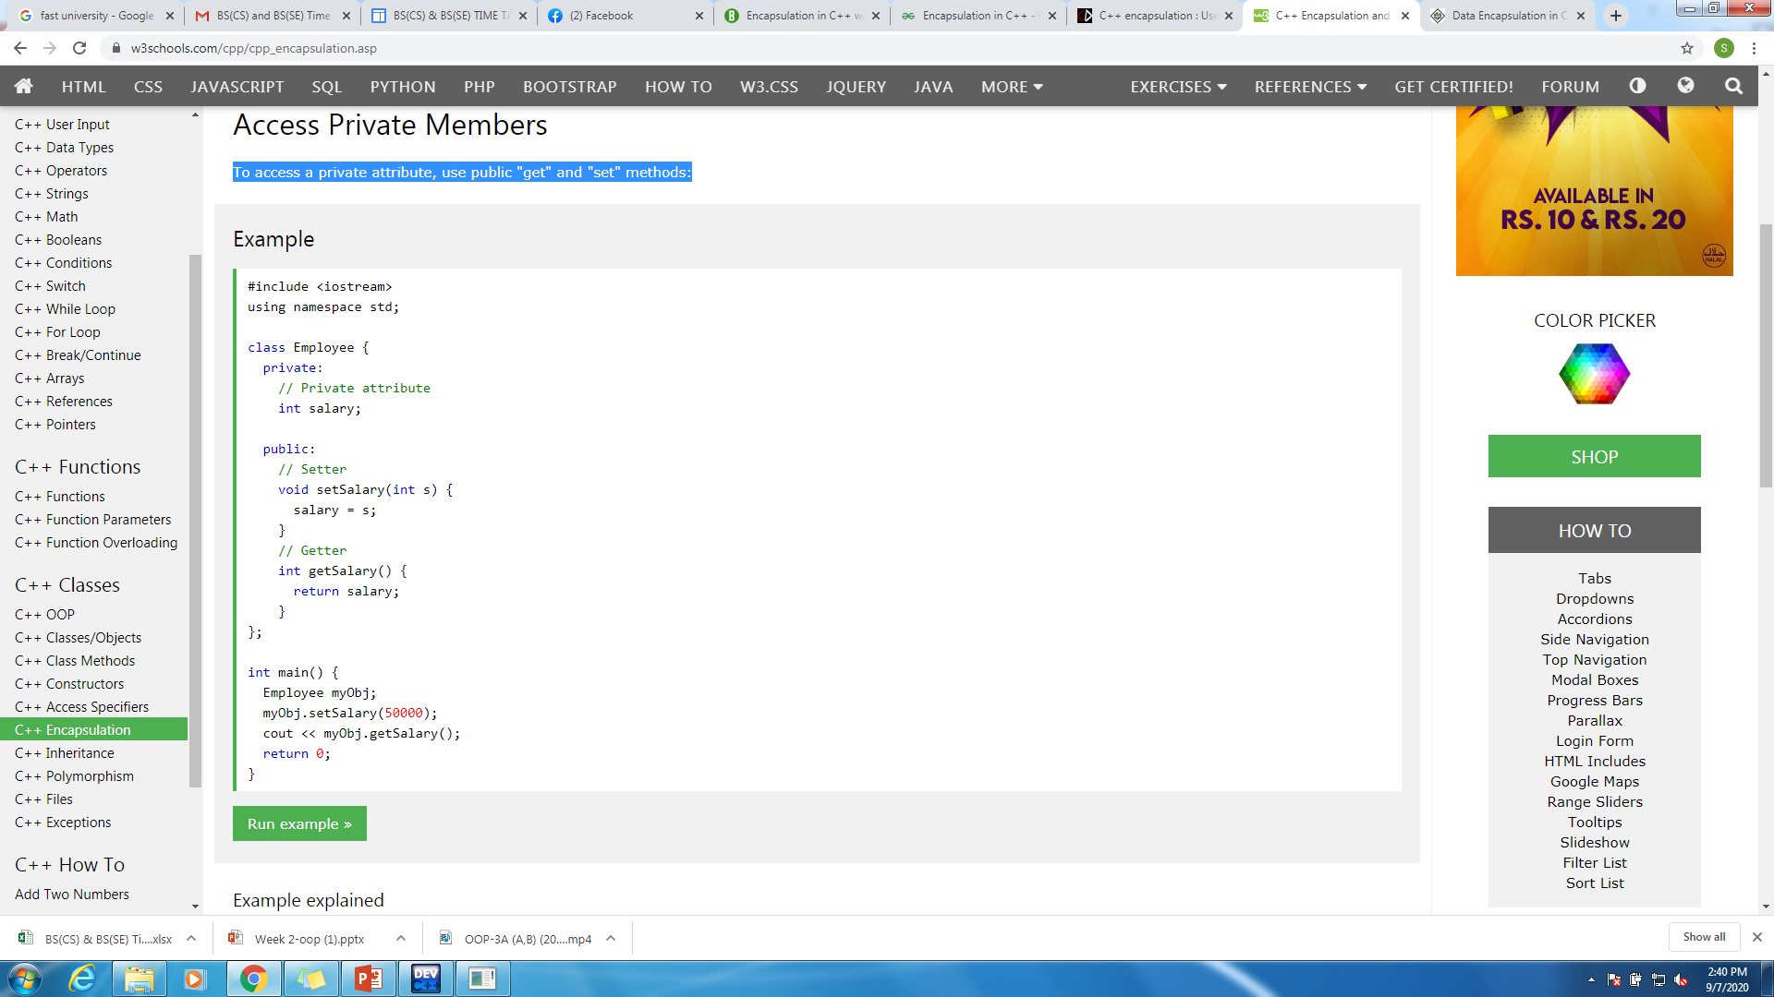
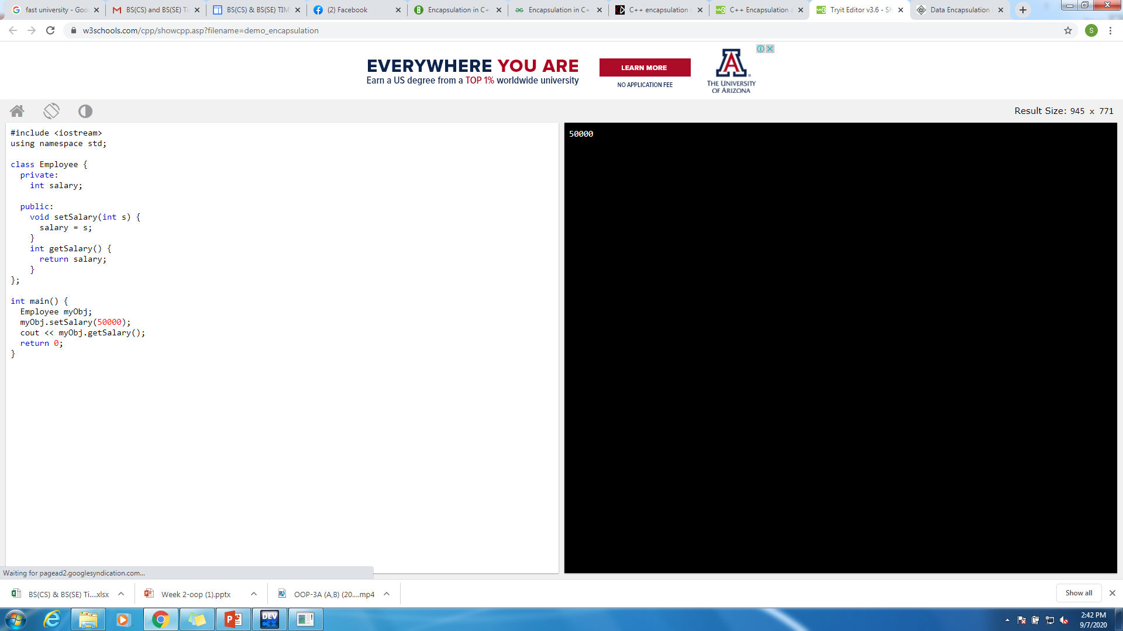
Encapsulation-Access Private Members
To access a private attribute, use public "get" and "set" methods:
The salary attribute is private, which have restricted access.
The public setSalary() method takes a parameter (s) and assigns it to the salary attribute (salary = s).
The public getSalary() method returns the value of the private salary attribute.
Inside main(), we create an object of the Employee class. Now we can use the setSalary() method to set the value of the private attribute to 50000. Then we call the getSalary() method on the object to return the value

Slide 33
Types Of Encapsulation
There are three types of encapsulations:
Member Variable Encapsulation
In this type of encapsulation, all the data members are declared as private.
Function Encapsulation
In this type of encapsulation, some of the member functions are declared as private. The constructor is public.
Class Encapsulation
In this type of encapsulation, all a class is declared as private. This is mostly done during nested classes.

Slide 34
Why Encapsulation
Encapsulation is necessary to keep the details about an object hidden from the users of that object.
Details of an object are stored in its data members (member bables).
This is the reason we make all the member variables of a class private and most of the member functions public.
Member variables are made private so that these cannot be directly accessed from outside the class (to hide the details of any object of that class like how the data about the object is implemented) and so most member functions are made public to allow the users to access the data members through those functions.
It is considered good practice to declare your class attributes as private (as often as you can). Encapsulation ensures better control of your data, because you (or others) can change one part of the code without affecting other parts
Increased security of data

Slide 35
Benefits of Encapsulation
Encapsulated classes reduce complexity.
Help protect our data. A client cannot change an Account's balance if we encapsulate it.
Encapsulated classes are easier to change. We can change the privacy of the data according to the requirement without changing the whole program by using access modifiers (public, private, protected). For example, if a data member is declared private and we wish to make it directly accessible from anywhere outside the class, we just need to replace the specifier private by public.

Slide 36
Abstraction
Data abstraction is one of the most essential and important feature of object oriented programming in C++.
Abstraction means displaying only essential information and hiding the details. Data abstraction refers to providing only essential information about the data to the outside world, hiding the background details or implementation.

Slide 37
Abstraction in OOP
Abstraction is selecting data from a larger pool to show only the relevant details to the object.
Abstraction is a way to cope with complexity.
Principle of abstraction:
“Capture only those details about an object that are relevant to current perspective”

Slide 38


Example – Abstraction
Driver’s View
Engineer’s View

Slide 39
Abstraction – Advantages
Simplifies the model by hiding irrelevant details
Abstraction provides the freedom to defer implementation decisions by avoiding commitment to details

Slide 40

Encapsulation vs Abstraction
S.NO | ABSTRACTION | ENCAPSULATION
1. | Abstraction is the process or method of gaining the information. | While encapsulation is the process or method to contain the information.
2. | In abstraction, problems are solved at the design or interface level. | While in encapsulation, problems are solved at the implementation level.
3. | Abstraction is the method of hiding the unwanted information. | Whereas encapsulation is a method to hide the data in a single entity or unit along with a method to protect information from outside.
4. | We can implement abstraction using abstract class and interfaces. | Whereas encapsulation can be implemented using by access modifier i.e. private, protected and public.
5. | In abstraction, implementation complexities are hidden using abstract classes and interfaces. | While in encapsulation, the data is hidden using methods of getters and setters.
6. | The objects that help to perform abstraction are encapsulated. | Whereas the objects that result in encapsulation need not be abstracted.

Slide 41
Example: The solution architect is the person who creates the high-level abstract technical design of the entire solution, and this design is then handed over to the the development team for implementation. Here, solution architect acts as a abstract and development team acts as a Encapsulation.
Encapsulation means-hiding data like using getter and setter etc.
Abstraction means- hiding implementation using abstract class and interfaces

Slide 42
Multiple Objects
You can create multiple objects of one class.
The benefit of multiple instances of a single class is that each of them can hold different values to their variables, and the methods only affect that specific object, so each of them have the same skeleton, but are in independent states.
An example of this is an enemy class in a game. If you have multiple enemies, you can create multiple instances of a class, where each enemy is an instance. They all may be in a different position, which could be a private variable of the class.

Slide 43
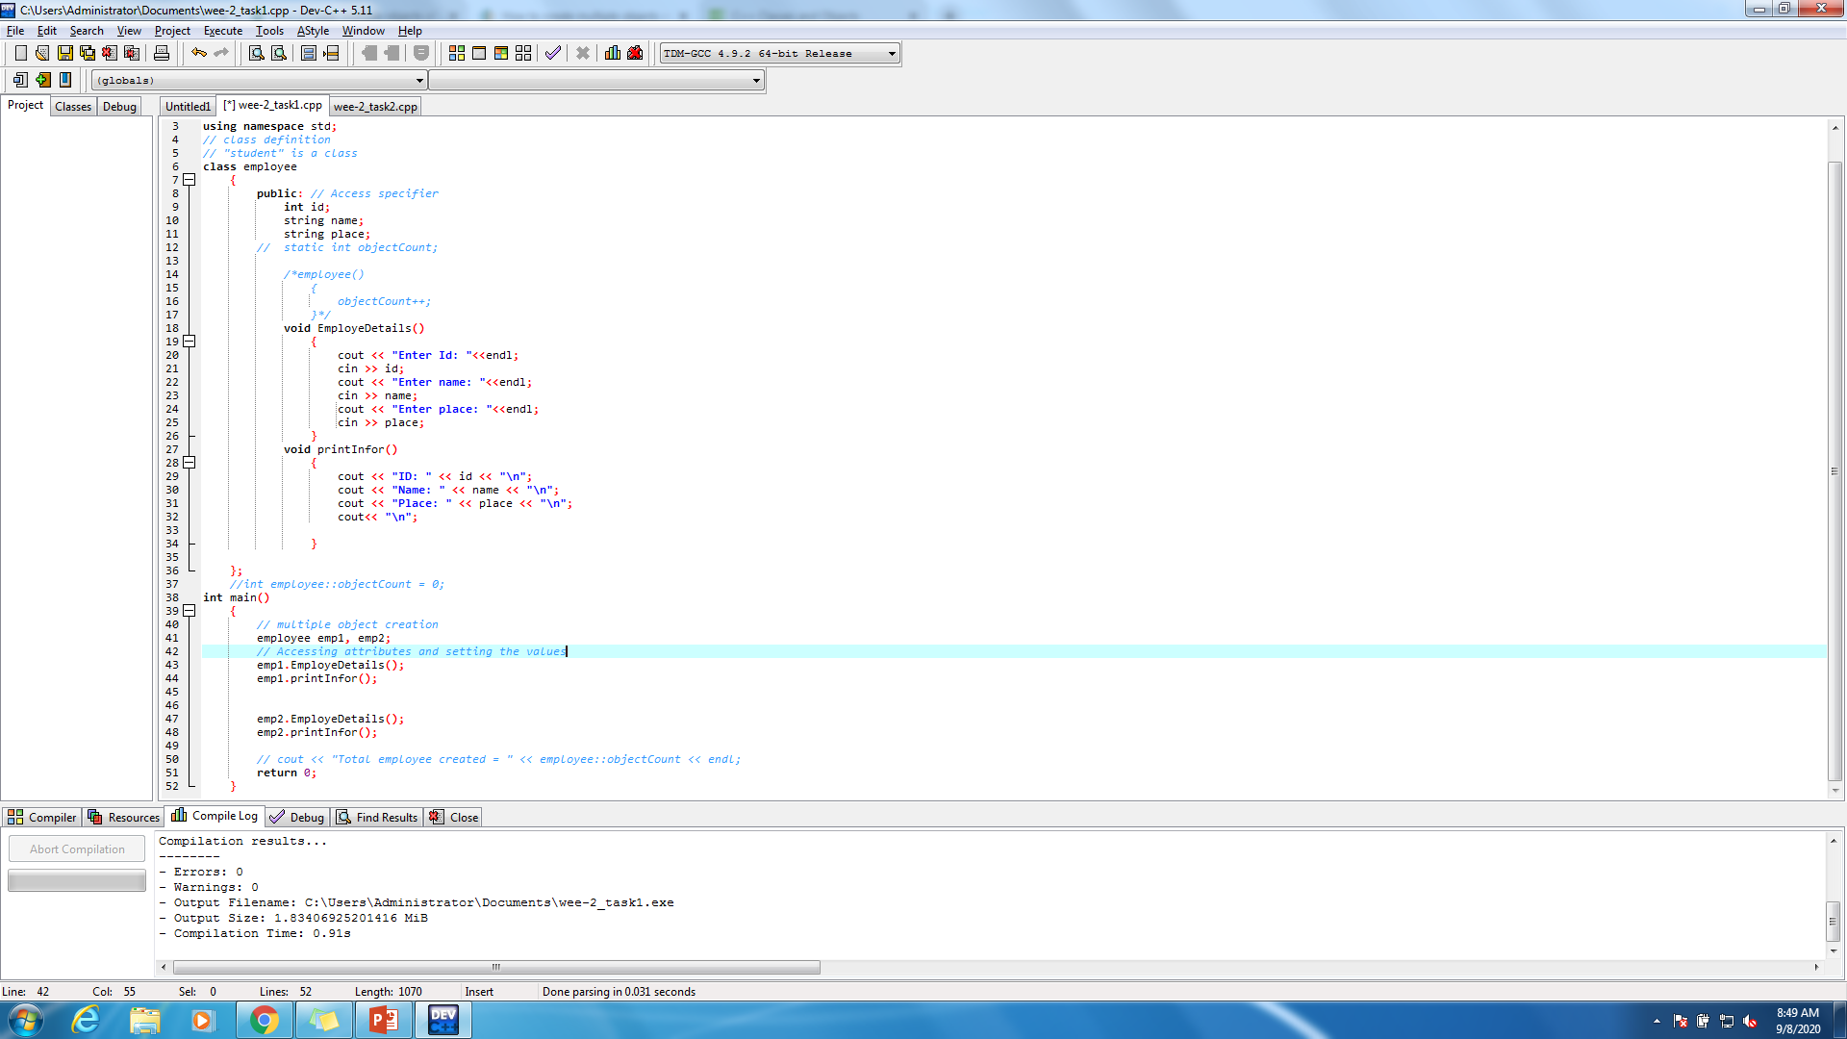
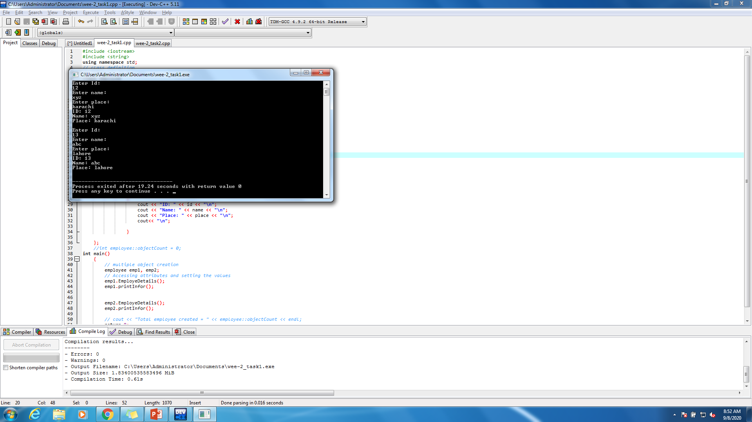
Introduction To Multiple Objects Into Real World

Slide 44
Introduction To Objects Into Real World
Object
instance of class
State of an object
Static and Dynamic
Behavior of an object
Behavior is how an object acts & reacts, in terms of its state change and message passing.
Identity of an object
Employee - Empid, Name, Gender, Mobile_No
Responsibility of an object
Responsibility of an object is the role it serves within the system.

Slide 45
Getter/Setter Functions
Getters and setters are as the name suggests functions that are created to set values and to fetch i.e. get values. These vastly work with classes a lot and are famous ways of doing the same in the coding paradigm

Slide 46
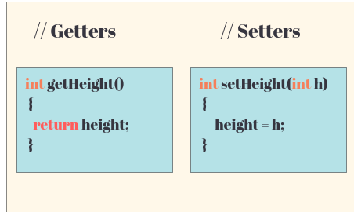
Getter/Setter Functions

Slide 47
Object v/s Classes
BASIS FOR COMPARISON | OBJECT | CLASS
Definition | An instance of a class is known as Object. | A template or blueprint with which objects are created is known as Class.
Type of entity | Physical | Logical
Creation | Object is invoked by. | Class is declared by using class keyword.
Memory allocation | Creation of object consumes memory. | The formation of a class doesn't allocate memory.

Slide 48
Generalized Class
- The class that only exhibits the common features of its objects.
Examples:
- ANIMAL
- BIRDS
- HUMAN

Slide 49
Specialized Class
- The class that exhibits different or unique features (behaviors)
ANIMAL (Generalized)
Specialized:
Mammals
Cats
Dog
ANIMAL
WILD PET
CAT CAT
Lion Streat Cat Persian Siamese

Slide 50
Type of classes
There are four distinct types of classes which are differentiated based on implementation. They are:
Base Classes/ Concrete Base class
Derived Classes / Concrete Derived class
Abstract Class

Slide 51
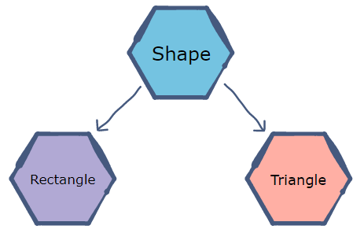
Abstract Class
Abstract class in C++ is a class that has at least one pure virtual function (i.e., a function that has no definition). The classes inheriting the abstract class must provide a definition for the pure virtual function; otherwise, the subclass would become an abstract class itself.
The purpose of an abstract class (often referred to as an ABC) is to provide an appropriate base class from which other classes can inherit.
For example, a Vehicle parent class with Truck and Motorbike inheriting from it is an abstraction that easily allows more vehicles to be added.
Abstract classes are essential to providing an abstraction to the code to make it reusable and extendable.

Slide 52
Virtual member function
A virtual member function for which no implementation is given is called a pure virtual function .
Virtual void fun() = 0;
Sometimes implementation of all function cannot be provided in a base class because we don’t know the implementation. Such a class is called abstract class.

Slide 53
Concrete Class
A concrete class is a class that can be used to create an object. An abstract class cannot be used to create an object (you must extend an abstract class and make a concrete class to be able to then create an object).
You can instantiate a concrete class.
A concrete class doesn’t have any abstract methods.
It is not mandatory to inherit a concrete class to use it.

Slide 54
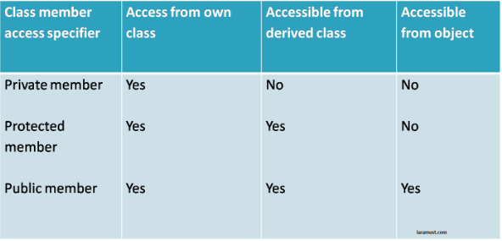
Access Control
Public
Private
Protected

Slide 55
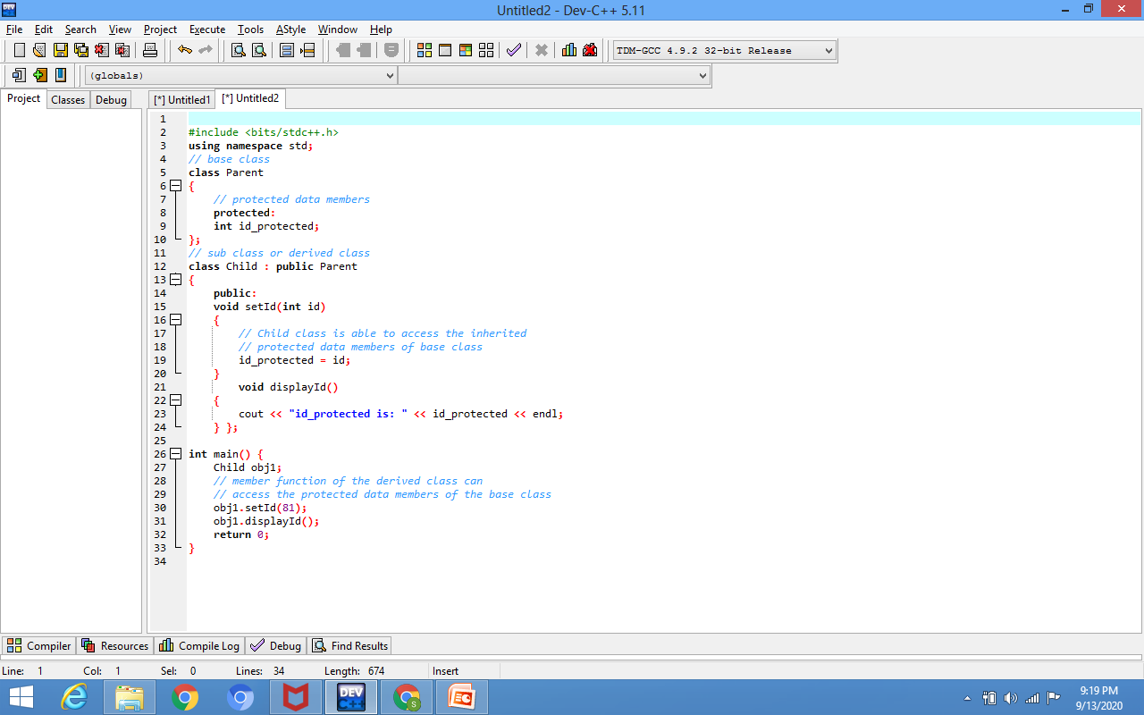
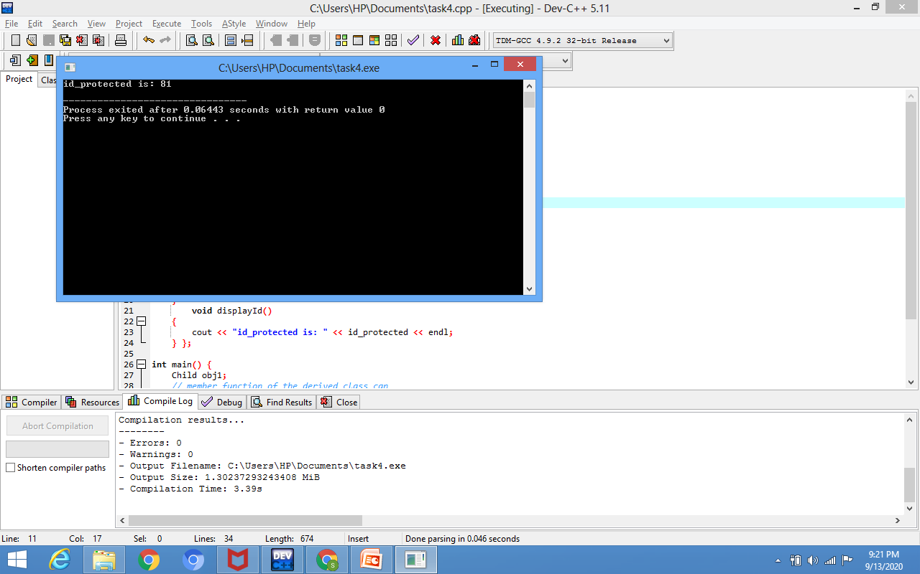
Protected-Modifier
Protected access modifier is similar to that of private access modifiers, the difference is that the class member declared as Protected are inaccessible outside the class but they can be accessed by any subclass(derived class) of that class.

Slide 56
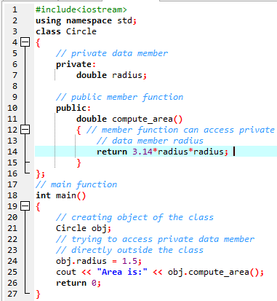
Private Modifier
The class members declared as private can be accessed only by the functions inside the class. They are not allowed to be accessed directly by any object or function outside the class.
The output of above program will be a compile time error because we are not allowed to access the private data members of a class directly outside the class.

Slide 57
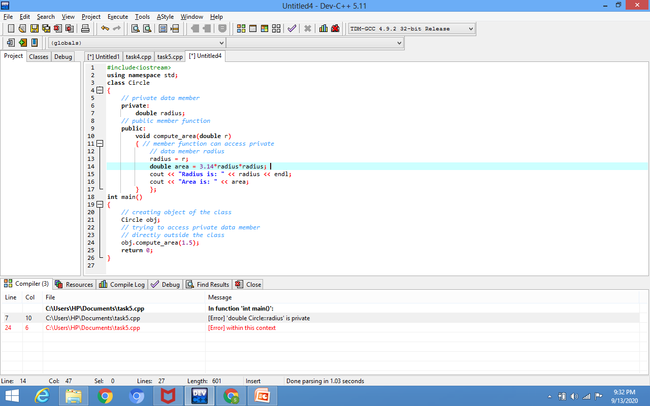
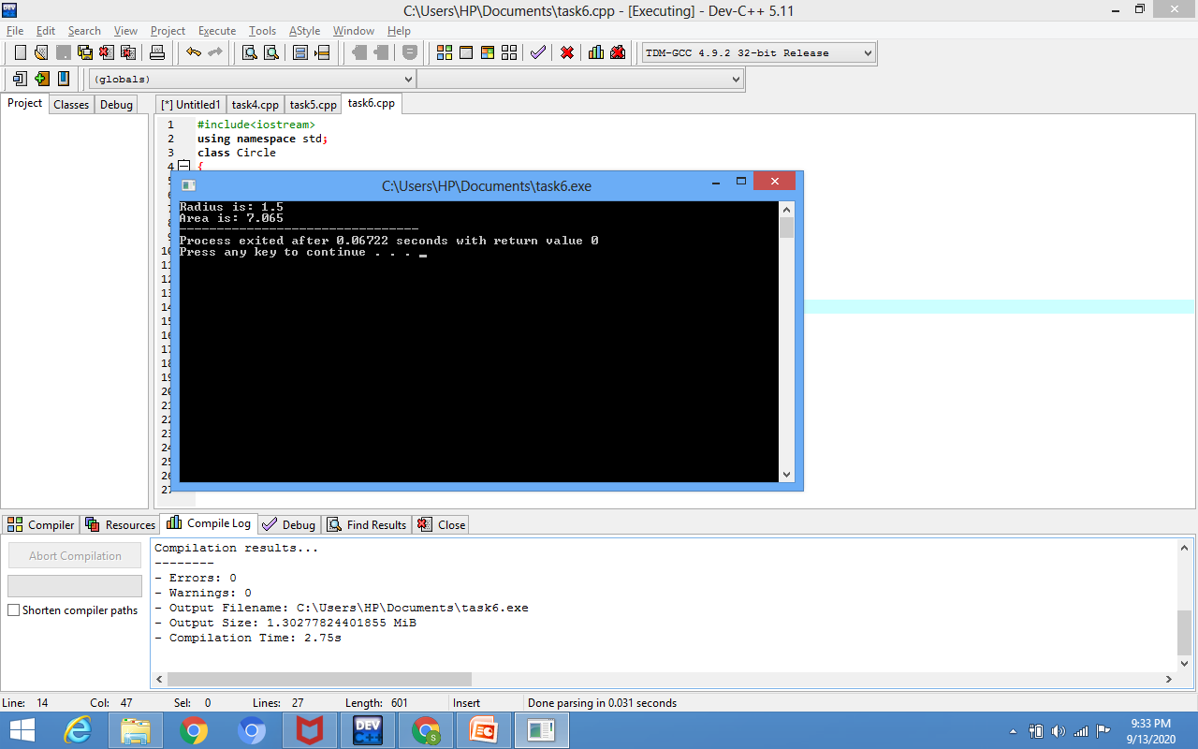
Private Modifier

Slide 58
Constructor
A constructor is a member function of a class which initializes objects of a class.
It has the same name of the class.
It must be a public member.
No Return Values.
Default constructors are called when constructors are not defined for the classes.

Slide 59
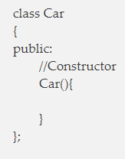
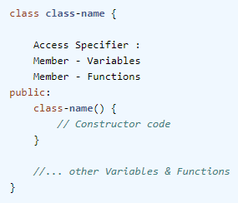
Constructor cont'd
If we do not specify a constructor, C++ compiler generates a default constructor for us (expects no parameters and has an empty body).
For example, in below class Car, constructor name will also be Car().

